Slide 1
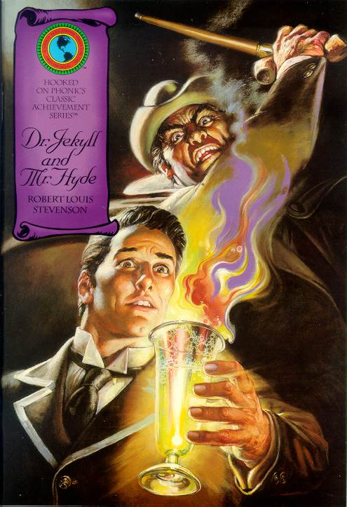
"The Strange Case of Dr. Jekyll and Mr. Hyde"
An Introduction

Slide 2
Robert Louis Stevenson
1850-1894
Scottish essayist, poet, and author of fiction and travel books
Many stories have horror and supernatural elements
Characters often prefer unknown hazards to everyday life of Victorian society.
Gained first fame with the romantic adventure story Treasure Island (a combination of travel adventure and romance)

Slide 3
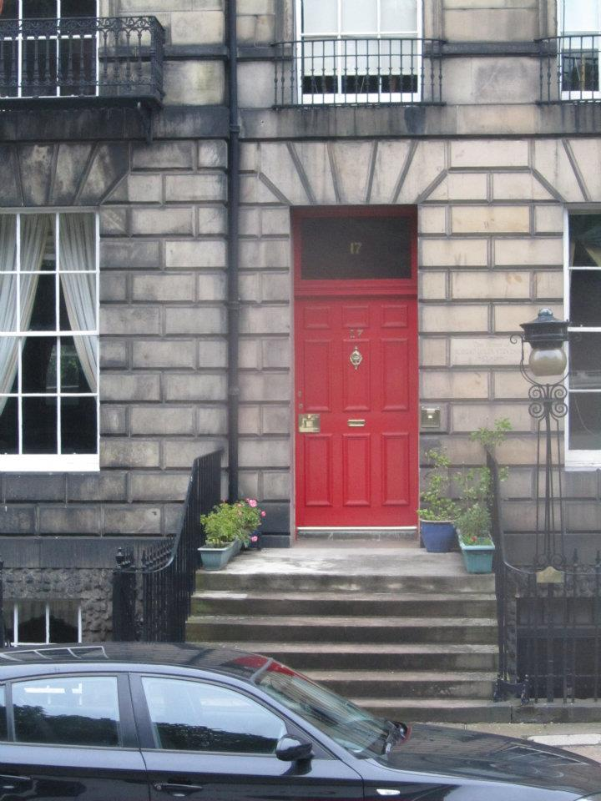
This is the outside of the home where Robert Louis Stevenson grew up in Edinburgh, Scotland.

Slide 4
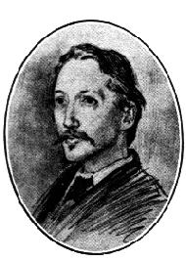
Since his childhood, suffered from tuberculosis. During his early years, he spent much of his time in bed, composing storied before he had learned to read.
In an attempt to improve his health, Stevenson travelled on the Continent and in the Scottish Highland. These trips provided him with many insights and inspiration for his writing.
Died of a brain hemorrhage on December 3, 1894

Slide 5
Why did he write it?
"The Strange Case of Dr. Jekyll and Mr. Hyde" was published in January of 1886.
Stevenson was interested in what made up a person’s character: why they could be bad as well as good.
He came from a good family but he was fascinated by the "dregs of humanity", something that the upper class pretended never existed.
After a nightmare, Stevenson wrote the story of Dr. Jekyll in just three days.

Slide 6
Novella
Longer and more complex than short stories but shorter and simpler than novels.

Slide 7
The Setting:
Victorian London

Slide 8
Victorian Era
1830s-beginning of 1900s
Queen Victoria ruled 1837-1901
Britain world’s leading economic and military power
Controlled a vast empire
Period of intense changes in many areas (Railroads, postal system, medicine, industry
People flocked to cities in search of work
1880s poverty began to become a problem
Changes in traditional society frightened many Britons.

Slide 9
London in the 1880s
Jekyll’s fine home in a formerly grand neighborhood now in decay
Lanyon’s comfortable home in Cavendish Square (many distinguished doctors have their houses and offices)
Hyde’s house in Soho, a part of London known for its immigrant populations.

Slide 10
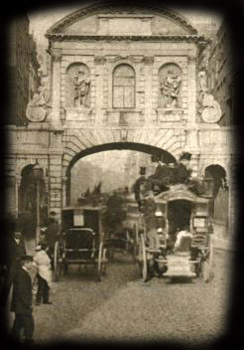

Slide 11
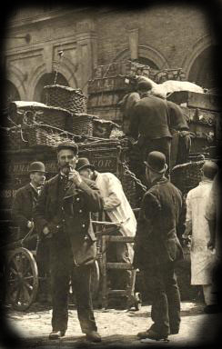

Slide 12
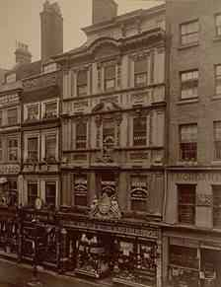

Slide 13
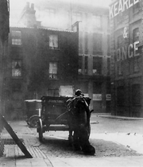

Slide 14
Victorian London Readers
Sold over 40,000 copies in 6 months
Conflict between Jekyll and Hyde reveals era’s class phobias
Story of double personality and metamorphosis appealed strongly to Victorian readers

Slide 15
Doppelganger
Concept of a “double-self” or “twin”
Alter Ego: The continual struggle of
who we are and who we are expected to be.
Popular in 1800s
Genre began with a story about this type of double when Dr. Frankenstein created his monster in 1818
Characters have become part of cultural mythology

Slide 16
Stevenson was very interested in the contrast between good and evil and he showed this in how he described the setting before Mr Enfield and Mr Utterson start talking about Mr. Hyde.

Slide 17
It chanced on one of these rambles that their way led them down a by-street in a busy quarter of London. The street was small and what is called quiet, but it drove a thriving trade on the weekdays. The inhabitants were all doing well, it seemed and all hoping to do better still - the shop fronts stood along that thoroughfare with an air of invitation, like rows of smiling saleswomen. Even on Sunday, when it veiled its more florid charms and lay comparatively empty of visitors, the street shone out in contrast to its dingy neighbourhood, like a fire in a forest; and with its freshly painted shutters, well-polished brasses, and general cleanliness and cheerfulness of note, instantly caught and pleased the eye of the passenger.

Slide 18
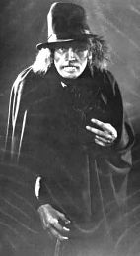
After the positive description of the street, comes the negative.

Slide 19
Two doors from one corner, on the left hand going east the line was broken by the entry of a court; and just at that point a certain sinister block of building thrust forward its gable on the street. It was two storeys high; showed no window, nothing but a door on the lower storey and a blind forehead of discoloured wall on the upper; and bore in every feature, the marks of prolonged and sordid negligence. The door, which was equipped with neither bell nor knocker, was blistered and distained. Tramps slouched into the recess and struck matches on the panels; children kept shop upon the steps; the schoolboy had tried his knife on the mouldings; and for close on a generation, no one had appeared to drive away these random visitors or to repair their ravages

Slide 20
Jot down the positive and negative descriptions.
POSITIVE
NEGATIVE

Slide 21
Good/ Evil
Does everyone have a little bit of both?

Slide 22
Problem Situation
You have recently become worried about one of your close friends. In your mind he has always been a good person. He is kind to everyone and is recognized as a school leader. He has worked as a math tutor for some of the younger students and has started a recycling program in the school. He is good at science and talks of going to medical school someday.

Slide 23
The cause of your worry for your friend is his secret fondness of drinking. He has used his chemistry skills to learn how to make homemade beer. Since his parents wouldn’t approve, he makes and stores the beer in an old shed behind his house which his parents never use. Your friend started off drinking only a beer or two but lately he is downing a six-pack an evening and he is changing. He becomes uninhibited and mean. He drives recklessly, and when you tell him he shouldn’t drink and drive he gets mad at you. Once he pushed you and told you what he did was none of your business. You fear that your friend is heading for serious trouble, and you wonder what you should do about it.

Slide 24
Free write about what you think might happen to your friend if he continues on this path. Also write down some ideas about what steps you might take to help him change his behavior.

Slide 25
Dual Nature/ Split Personality
Think about a time when you showed kindness to an animal or another person and then about a time when they were cruel or unkind.
Why might you act in these opposite ways at different times? What causes a person to act in such radically opposite ways and what does this suggest about human personality or human nature?

Slide 26
Dual Nature/ Split Personality
Many religions use the concept of dual nature to explain the struggle within a person to choose between good and evil. (Adam/Eve; Cain/Abel)
Horror and gangster films and fiction often explore the dual nature of a criminal by showing an evil person performing an act of kindness. For example, in the film The Godfather the gangster hero is shown playing with children and interacting with family and friends.

