Slide 1
Horror as a Genre

Slide 2
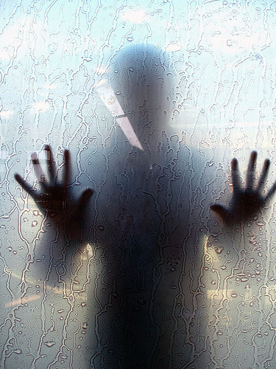
What is Horror Fiction?
Webster's definition:
Horror = "a painful and intense fear, dread, or dismay.“
So then…
"horror fiction" is fiction that elicits those emotions in the reader.
horror can deal with the mundane or the supernatural, with the fantastic or the normal. It doesn't have to be full of ghosts, ghouls, and things to go bump in the night, but it often does.
its only true requirement is that it elicit an emotional reaction that includes some aspect of fear or dread.

Slide 3
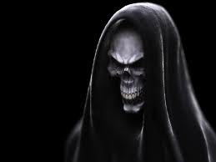
What is Horror Fiction?
In his 1982 horror anthology Prime Evil, author Douglas Winter stated,
"Horror is not a genre, like the mystery or science fiction or the western. It is not a kind of fiction, meant to be confined to the ghetto of a special shelf in libraries or bookstores. Horror is an emotion."

Slide 4
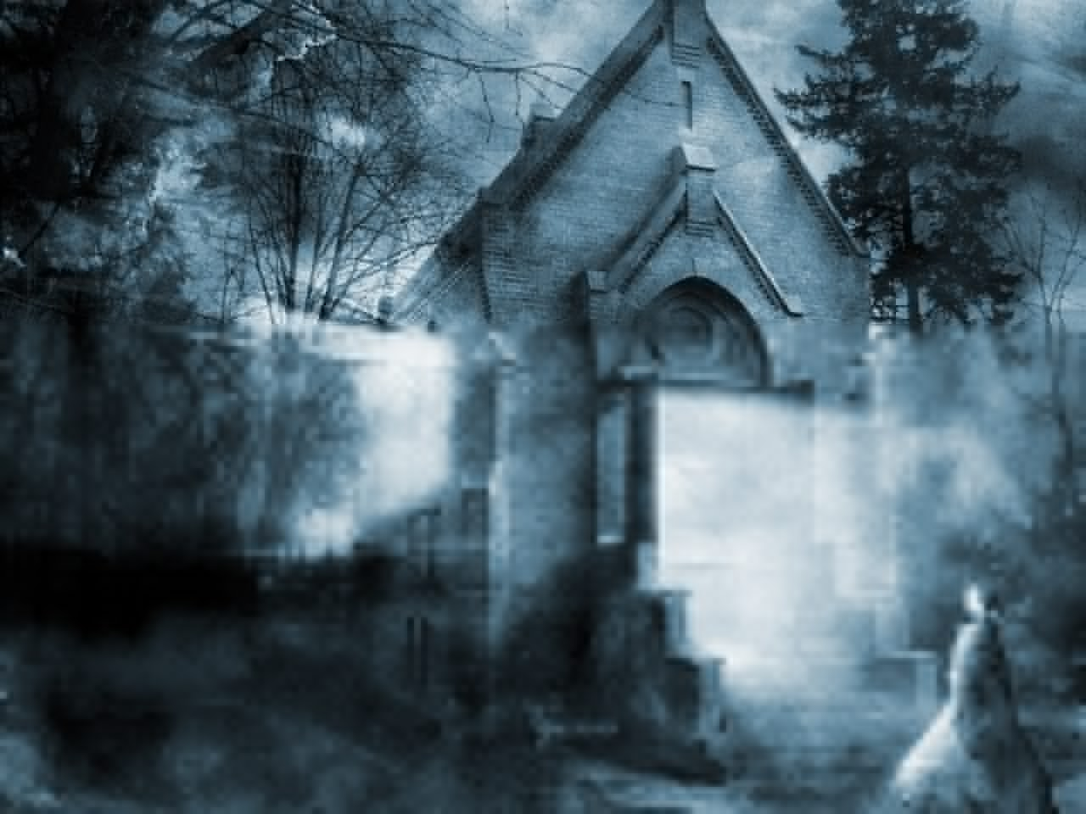
What is Horror Fiction?
Horror literature evokes the necessary atmosphere and sense of emotional dread by tapping into who we are as readers -- as people.
It speaks of the human condition and forcibly reminds us of how little we actually know and understand.
Give examples of what we are afraid of as children (i.e. monster under the bed)
Give examples of what we are afraid of as adults (i.e. death of a loved one)
Horror, by nature, is a personal touch -- an intrusion into our comfort levels.

Slide 5
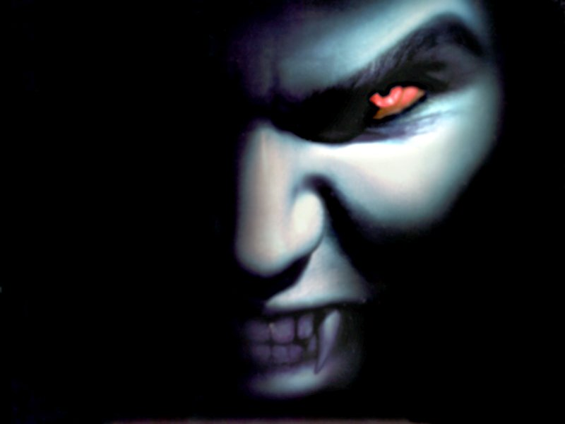
What is Horror Fiction?
Robert McCammon, one of the founders of the Horror Writers Association, said,
"Horror fiction upsets apple carts, burns old buildings, and stampedes the horses; it questions and yearns for answers, and it takes nothing for granted. It's not safe, and it probably rots your teeth, too. Horror fiction can be a guide through a nightmare world, entered freely and by the reader's own will. And since horror can be many, many things and go in many, many directions, that guided nightmare ride can shock, educate, illuminate, threaten, shriek, and whisper before it lets the readers loose."
(Twilight Zone Magazine, Oct 1986)

Slide 6
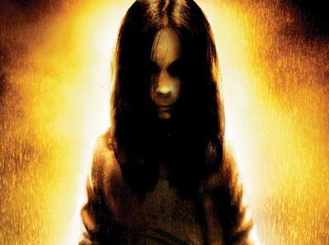
What is Horror Fiction?
Horror writing delves deep inside and forces us to confront who we are, to examine what we are afraid of, and to wonder what lies ahead down the road of life.

Slide 7
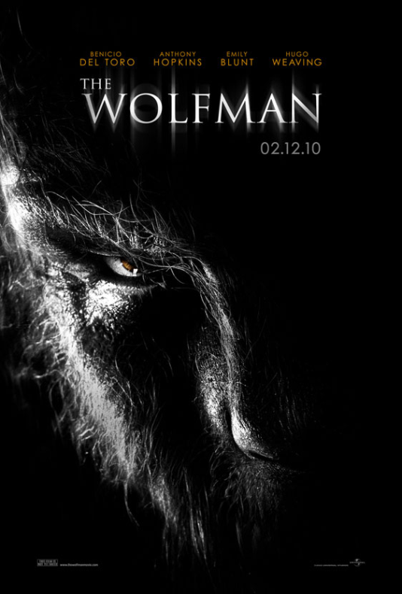
Types of Horror Fiction
The following is not a comprehensive list, and there are several different opinions on what are the true sub-genres of horror fiction, but this list will give you a general idea. There will be much crossover between the sub-genres, so there really isn’t a wrong categorization.
For each sub-genre here, think of s some books or movies you’ve read or seen that fall into that category…

Slide 8
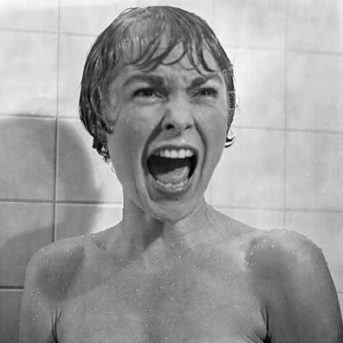
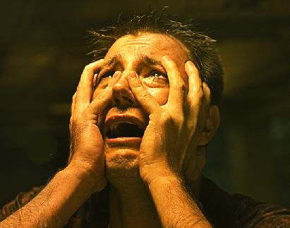
Types of Horror Fiction
REALISTIC HORROR SUB-GENRES:
Dark Fiction
fiction with malevolence and darkness being the prevalent idea but without fantastic elements
Dark Suspense/Thriller
no supernatural elements, but a constant sense of threat coming from an outside menace
may become more mystery when there is a strong investigative angle, or may be come more thriller when adding action and adventure

Slide 9
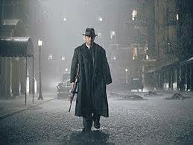
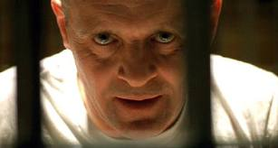
Types of Horror Fiction
REALISTIC HORROR SUB-GENRES:
Noir
set in an urban underworld of crime and moral ambiguity
dark, cynical, paranoid themes of corruption, violence, and revenge
set in dingy realism
Psychological Horror
based on the disturbed human psyche
usually set in realism, but can cross the line into the supernatural

Slide 10
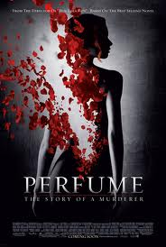
Types of Horror Fiction
REALISTIC HORROR SUB-GENRES:
Extreme Horror
goes straight to the blood-and-guts
aims for the gross-out
Visceral
earthier, more reality-based with a tendency to be “in your face” with descriptions of the bad stuff, but not as extreme as extreme horror
Quiet / Soft Horror
subtle with atmosphere and mood providing the miasma of fear rather than graphic description. The opposite of Extreme horror

Slide 11
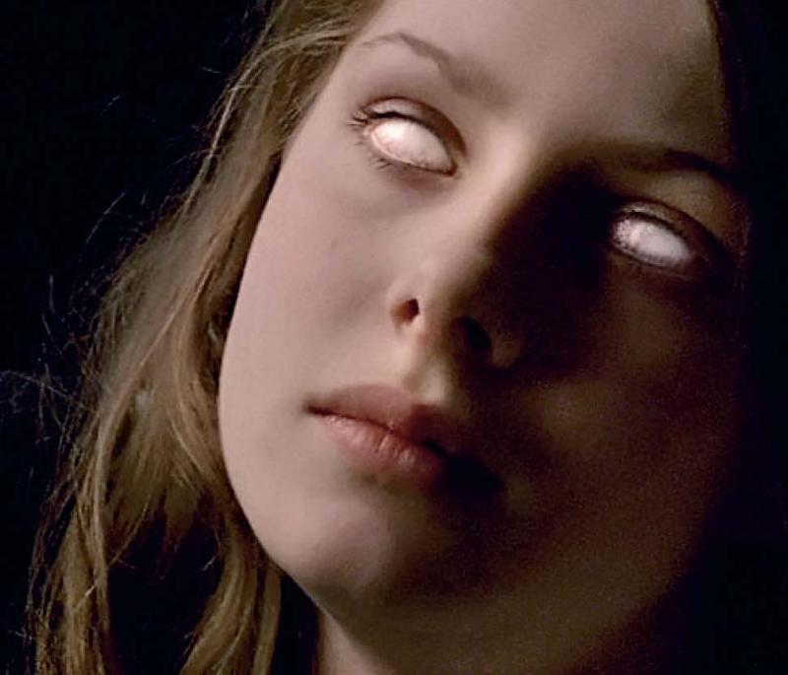
Types of Horror Fiction
FANTASTIC HORROR SUB-GENRES:
Cross Genre/Slipstream
when genres (horror, fantasy, science, and speculative fiction) slip into one another
Weird Horror
strange, uncanny, supernatural stories
often considered “pulp”
Surreal
anything unreal, strange, and bizarre

Slide 12
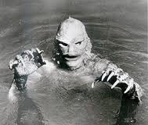
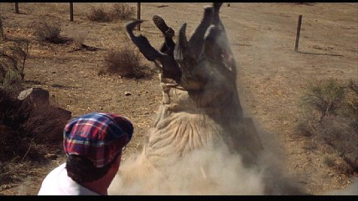
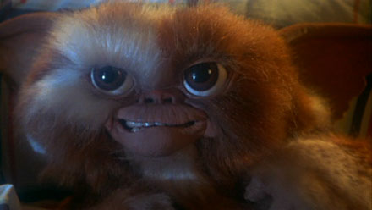
Types of Horror Fiction
FANTASTIC HORROR SUB-GENRES:
Creature/Monster Horror
When animals go bad and creatures hunt humans
Often set in reality and only the creature is unrealistic

Slide 13
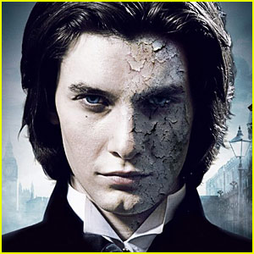
Types of Horror Fiction
FANTASTIC HORROR SUB-GENRES:
Gothic Horror
English Gothic:
novels and tales dominating English literature from 1764 until the early 19th century.
Characteristic theme is the stranglehold of the past on the present, or the encroachment of the dark ages upon the enlightened modern era.
Uses enclosed and haunted settings (castles, crypts, convents, mansions), gloomy images of ruin and decay, episodes of imprisonment, cruelty, and persecution to express this
Example: Oscar Wilde’s Picture of Dorian Gray
American Gothic:
same era as English gothic but has more of a psychological interest in aberrant mentality rather than a gloomy atmosphere.
Example: Turn of the Screw

Slide 14
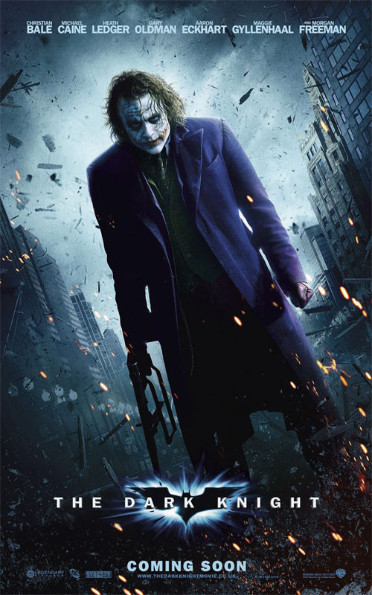
Types of Horror Fiction
FANTASTIC HORROR SUB-GENRES:
Supernatural
the rules of the normal world don’t apply…ghosts, demons, vampires, werewolves, the occult, etc.
Dark Fantasy
a fantasy story with supernatural elements, but without fantastic creatures like vampires, werewolves, etc.
Examples: modern interpretations of Batman and Spiderman

Slide 15
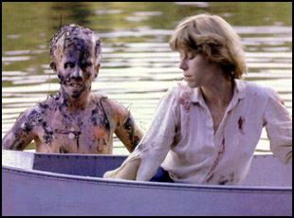
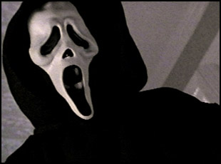
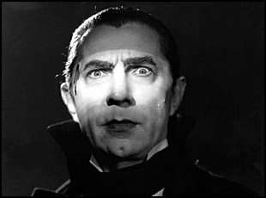
A Few Popular Horror Movies
Friday the 13th
Scream
Dracula

Slide 16
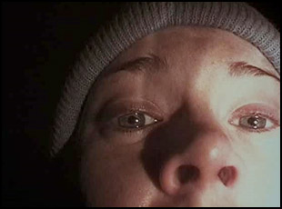
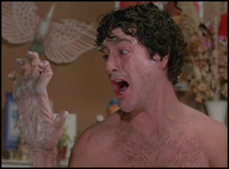
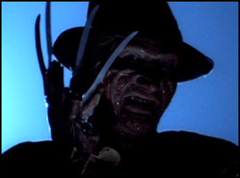
A Few Popular Horror Movies
Blair Witch Project
An American Werewolf in London
A Nightmare on Elm Street

Slide 17
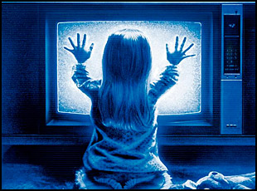
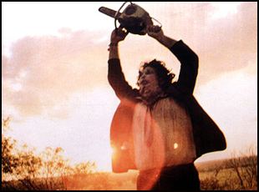
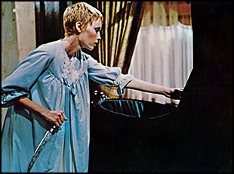
A Few Popular Horror Movies
Poltergeist
The Texas Chainsaw Massacre
Rosemary’s Baby

Slide 18
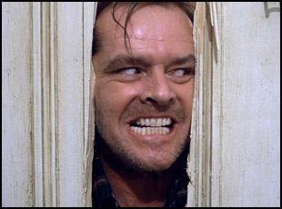
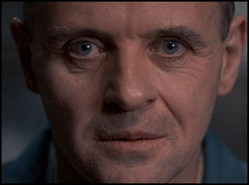
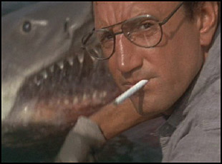
A Few Popular Horror Movies
The Shining
Silence of the Lambs
Jaws

Slide 19
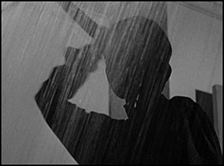
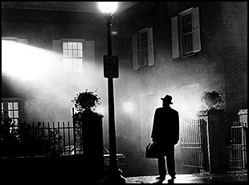
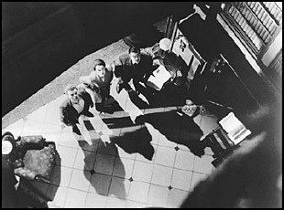
A Few Popular Horror Movies
Psycho
The Exorcist
The Haunting

Slide 20
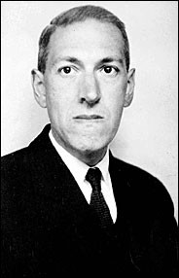
Some Top Horror Writers (a very subjective list)
H.P. Lovecraft
Thought by most to be the very best horror writer of all time.
Lovecraft’s influence has not waned, even more than 70 years after his death.
His works have been adapted into film, TV, comic books, video games, and role-playing games.
The conception of the Cthulhu Mythos, and its pantheon of terrifying deities and monstrosities remains the most important creation in horror during the 20th century.
His most famous Mythos stories include The Unnamable, The Call of Cthulhu, The Colour out of Space, The Dunwich Horror, At the Mountains of Madness, The Shadow over Innsmouth, Dreams in the Witch House.
His genius was taking various ideas and concepts and molding them into a coherent, shared landscape that still has many active writers today.

Slide 21
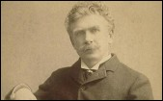
Some Top Horror Writers (a very subjective list)
Ambrose Bierce
Wrote one of the most famous horror stories of the 1800s, An Occurrence at Owl Creek Bridge.
This story is about a Confederate sympathizer who is about to be hanged when the rope breaks and he falls into the creek, escaping to return to his wife and children…only to find it was all an illusion as he feels a sharp pain in his neck and all goes black as he dies at the end of the rope

Slide 22
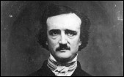
Some Top Horror Writers (a very subjective list)
Edgar Allan Poe
Infatuated with death and themes of premature burial and torture.
Poe’s stories read like the Hall of Fame of horror tales: The Black Cat, The Cask of Amontillado, The Fall of the House of Usher, The Masque of the Red Death, The Murders in the Rue Morgue, The Pit and the Pendulum, The Tell-Tale Heart, The Premature Burial, and Ligeia.
All of these stories have been adapted for film or TV, some multiple times.

Slide 23
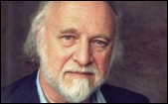
Some Top Horror Writers (a very subjective list)
Richard Matheson
His accomplishments in the horror field are staggering!
His 1954 novel I am Legend is one of the top ten greatest horror novels ever written. Hollywood has failed to do the story justice in three attempts so if you haven’t read the book you DON’T know the story.
So many of Matheson’s stories have been turned into feature films or TV episodes or movies including The Incredible Shrinking Man, Stir of Echoes, and Hell House (The Legend of Hell House).
His story, Duel, about a motorist stalked by a trucker along a remote highway is regarded as one of the great TV films of all time and was the first film directed by Steven Spielberg.

Slide 24
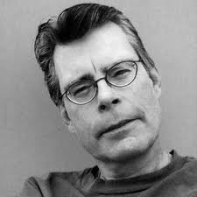
Some Top Horror Writers (a very subjective list)
Steven King
There simply is no more important person in horror literature in the past 40 years than Stephen King.
His books have sold over 300 million copies.
King has won 6 Stoker awards, 6 Horror Guild awards, 5 Locus Awards, 3 World Fantasy Awards (including a Lifetime Achievement Award in 2004).
He was given a Lifetime Achievement Award in 2003 by the Horror Writers' Association.
Some of his books: Carrie (1974) , Salem’s Lot (1975), The Shining (1977), The Stand (1978), Christine (1983), Pet Sematary (1983), The Talisman W/ Peter Straub (1984), It (1986), Misery (1987)

Slide 25
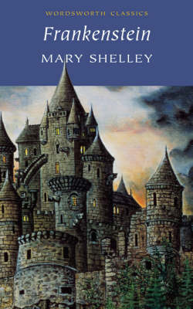
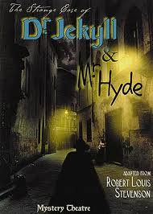
Must-Read Horror Classics
Frankenstein by Mary Shelley
Named for mad scientist Dr. Henry Frankenstein, Mary Shelley's iconic Frankenstein tells the heartbreaking life story of a nameless Monster, a creature artificially pieced together by Dr. Frankenstein who terrorizes a Bavarian village after being cast off by society.
The Strange Case of Dr. Jekyll & Mr. Hyde
by Robert Louis Stevenson (1886)
Tells the sweeping story of Dr. Henry Jekyll, who descends into madness as he succumbs to a murderous alter ego, Mr. Hyde. The details surrounding Jekyll's transformation are peeled back in layers and chronicle the science that initially transforms and is ultimately unable to save Jekyll from Hyde.

Slide 26
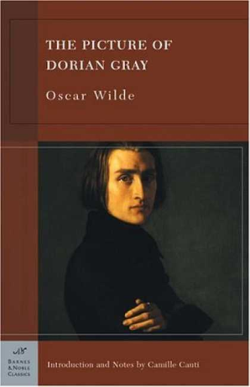
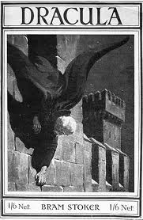
Must-Read Horror Classics
The Picture of Dorian Gray by Oscar Wilde
Oscar Wilde's only novel, The Picture Of Dorian Gray is a beautifully brooding account of a man whose vanity leads him to wish for everlasting youth, and the spiraling menace of immortality.
Dracula by Bram Stoker
Bram Stoker's classic vampire novel Dracula is the backbone of vampirism as it's perceived in modern pop culture: sexually appealing, sophisticated creatures of the night who enchant and seduce their prey. Centered around Jonathan Harker's observations as the creature Count Dracula enters his life, the book is full of old charm and striking language.

Slide 27
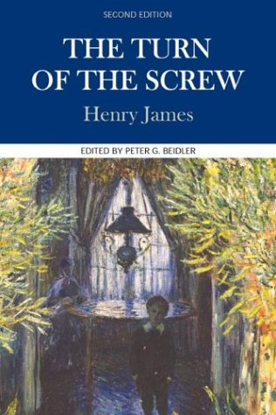
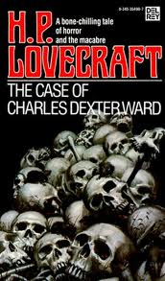
Must-Read Horror Classics
The Turn of the Screw by Henry James
Henry James' The Turn Of The Screw is a classic ghost story of unexplained events that slowly drive a young governess to question her own sanity, or believe in the paranormal events unfolding around her. Whether the 1898 story of explains a haunting or a case of extreme paranoia is left for the reader to decide.
The Case of Charles Dexter Ward by H.P. Lovecraft
The evil center of one of literary supernaturalist H.P. Lovecraft's greatest novels pretty much bursts with paranormal goo. As a young man, the novel's titular character Charles Dexter Ward, summons the spirit of a murderous ancestor, but his search for family history goes deathly wrong.

Slide 28
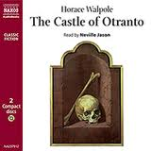
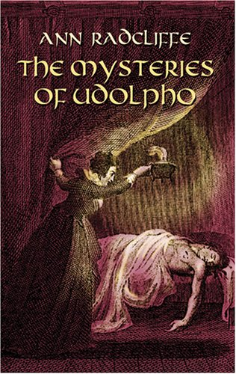
Must-Read Horror Classics
The Castle of Otranto by Horace Walpole
Driven by insatiable greed, Lord Manfred sets into motion a tragic story of reveal that always comes too late. Published in 1764, The Castle of Otranto is considered the English first gothic novel
The Mysteries of Udolpho by Ann Radcliffe
A Cinderella-like story with dark roots The Mysteries of Udolpho is the fourth novel from author Ann Radcliffe. Published in 1794, the plot follows a suffering orphan, entrapped by her uncle and denied her inheritance and left to investigate the mysterious happenings from inside the castle.

Slide 29
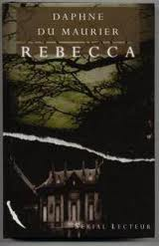
Must-Read Horror Classics
Rebecca by Daphne Du Maurier
Best recognized as one of Alfred Hitchcock's classic flicks, Rebecca is Daphne du Maurier's story of a lingering influence of a dead woman over a household, inflated by a devoted housekeeper. Though paranormal activity is entirely absent from the book, the powerful manipulation of villain Mrs. Danvers is near psychotic and enough to make the heroine teeter on insanity.

